Slide 1
AnalyZing Amazon Sales data
BY:- ABHI SAHU

Slide 2
Problem Statement
Sales management has gained importance to meet increasing competition and the need for improved methods of distribution to reduce cost and to increase profits.
Do ETL: Extract-Transform-Load some Amazon dataset and find for me Sales-trend Month-Wise, Year-Wise, Yearly_Month-Wise.
Find key metrics and factors and show the meaningful relationships between attributes.

Slide 3
Details of Data
Data of around 100 Countries from 7 Different Regions was taken for Analysis.
Table contain around 15 columns of different data set Ex. Total Revenue, Total Cost, Total Profit, Region, Item Type, Order Date, Order ID, Units Sold, Unit Price, Unit Cost etc.

Slide 4
Main KPIs
Total Revenue
Total Profit
Units Sold
Profit Margin
Sales by Region
Tools Used for Analysis are – Excel and Power Bi
LINK To Dashboard :- Power Bi Template https://drive.google.com/file/d/1wgu6tPj_azppyJZy1Buxkn-j_zhlQFE3/view?usp=sharing
Pdf :- https://drive.google.com/file/d/1kSmLWTklLG5tqFyuxt3IYH0cbH-K9meW/view?usp=drive_link

Slide 5
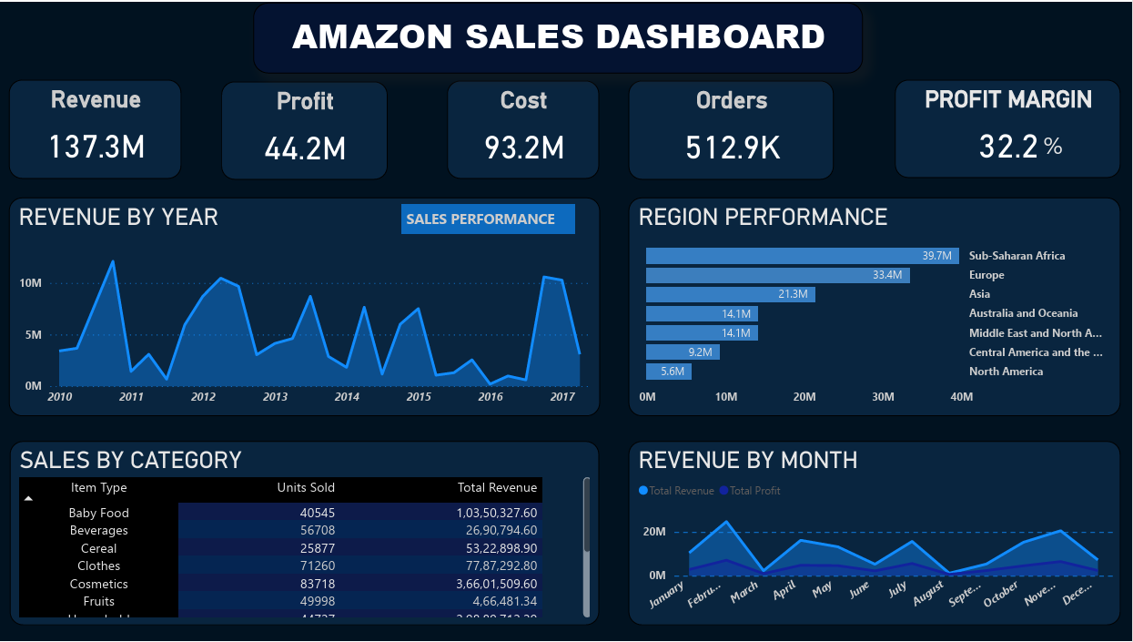
My Design

Slide 6
Thank You

